Slide 1

Utilizing CNN and Transfer Learning on AWS for Brain Tumor Classification from MRI Data
Project by:
Manish Rawat (2084696)
Jainish Shah (2219256)
Kaushal Dhanani (2154027)
Purva Dixitkumar Desai (1826341)

Slide 2
Agenda
Introduction
Data Profiling
Project Pipeline
Transfer Learning
EfficientNetB0 & ImageNet
Model Training & Evaluation
Future Scope & Conclusion

Slide 3
Introduction
What is Brain Tumor?
A brain tumor is an abnormal growth of cells in the brain. Tumors can be benign (noncancerous) or malignant (cancerous). They can grow in any part of the brain and can affect a person's thinking, movement, and other functions.
Types of Brain Tumor
Gliomas: These are the most common type of brain tumor, and they account for about 80% of all brain tumors. Gliomas arise from the glial cells, which are the supporting cells of the brain.
Meningiomas: These tumors arise from the meninges, which are the membranes that cover the brain and spinal cord. Meningiomas are usually benign and slow-growing.
Pituitary adenomas: These tumors arise from the pituitary gland, which is a small gland located at the base of the brain. Pituitary adenomas can cause a variety of hormones to be produced in excess or too little.
Acoustic neuromas: These tumors arise from the eighth cranial nerve, which is responsible for hearing and balance. Acoustic neuromas are usually benign and slow-growing.
Problems of detection?
Brain tumors can be difficult to detect because they often grow slowly and do not cause symptoms until they are large enough to press on nearby brain tissue.

Slide 4
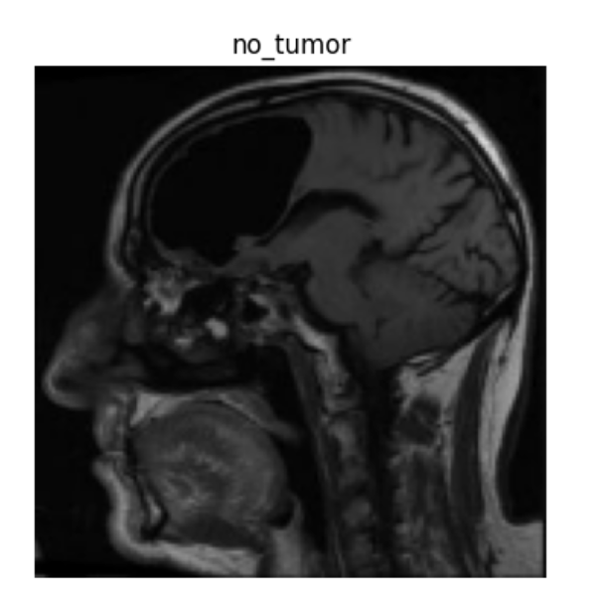
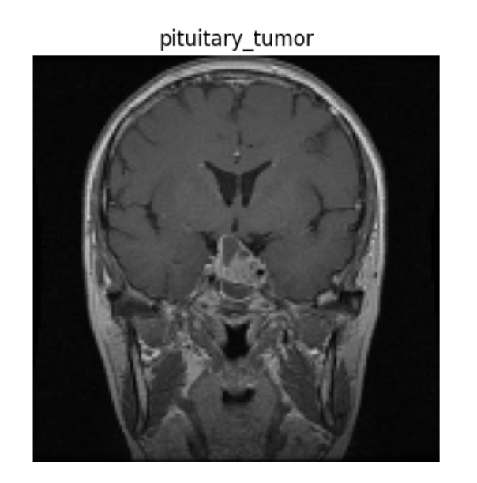
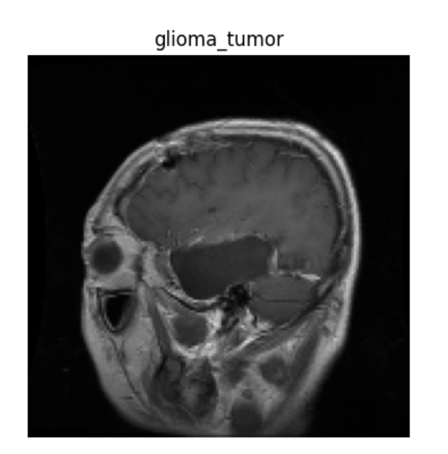
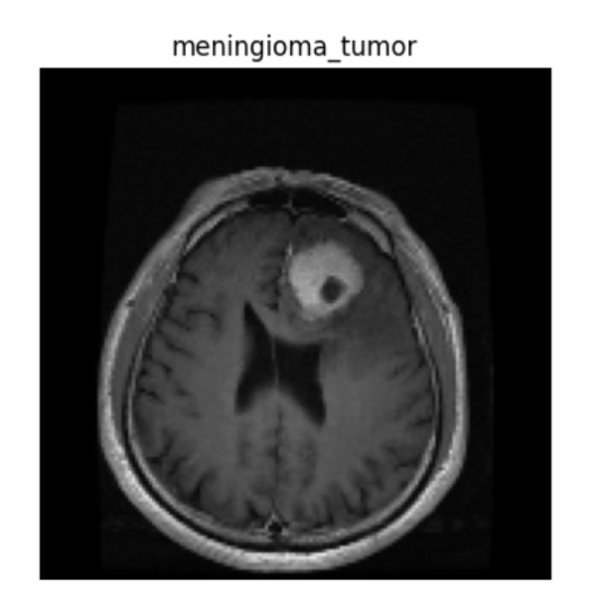
Sample Dataset
Fig 1: Types of Brain Tumor

Slide 5
Data Profiling
Objective - The objective is to develop a data-driven alternative method for classifying if a person has a brain tumor or not using CNN & Transfer Learning.
Dataset- The MRI dataset for brain tumor classification, available on Kaggle, is employed for this project under the CC0 license, facilitating collaborative research and innovation in the medical field. Kaggle Link
Problem Category - Classification
Total Number of Instances - 3271 images
Number of Attributes - 4 types of image set
- Class 0 as Glioma Tumor, which has T-826 & V-101 images: Total-927
- Class 1 as No Tumor, which has T-396 & V-106 images: Total-502
- Class 2 as Meningioma Tumor, which has T-823 & V-116 images: Total-939
- Class 3 as Pituitary Tumor, which has T-828 & V-75 images: Total-903
Data Preprocessing
- Resized images to 150x150 pixels.
- One hot encoding Target Label to numeric value.

Slide 6
Project Pipeline
Data Collection
Data Preprocessing
Model Training using
CNN & Transfer Learning
AWS Services
(EC2, S3, Sagemaker)
AWS lambda
Testing & Evaluation
Prediction
Final Client
Part 1: Model Development
Part 2: Model Deployment
Fig 2: Project Pipeline

Slide 7
Transfer Learning
Transfer learning is a machine learning technique where knowledge learned from one task is reused to improve performance on a related task.
Transfer learning is often used in deep learning, where training a model from scratch can be very time-consuming and computationally expensive.
By using transfer learning, researchers can leverage the knowledge learned from large datasets to train models for new tasks more quickly and efficiently.
Our project leverages the power of the EfficientNetB0 model and utilizes pre-trained weights from the ImageNet dataset to advance the accuracy and efficiency of brain tumor classification. EfficientNetB0 is renowned for being the smallest and fastest member of the EfficientNet family. It's well-suited for our task as it offers excellent performance while requiring fewer computational resources.
ImageNet-trained models, including EfficientNetB0, have already learned to recognize a vast array of features, shapes, and objects. This prior knowledge is instrumental in understanding intricate patterns in various images.
By starting with weights that have already learned valuable features, we considerably reduce the time and resources required for training. Instead of beginning with random weight initializations, we have a head start in fine-tuning the model for our specific task.

Slide 8
Model Architecture
EfficientNetB0 Output: Our starting point is the output of the EfficientNetB0 model. EfficientNetB0 serves as the feature extractor, capturing meaningful features from our brain tumor images.
Global Average Pooling 2D Layer: Following the feature extraction, we apply a GlobalAveragePooling2D layer. This layer transforms the multi-dimensional feature maps into a 1D vector. It calculates the average of the feature values, which is a powerful technique for reducing the spatial dimensions while preserving the most important information. This step helps in mitigating overfitting and improving computational efficiency.
Dropout Layer: We introduce a Dropout layer with a rate of 0.5. Dropout is a regularization technique that helps prevent overfitting by randomly setting a fraction of the input units to 0 during each training iteration. In our case, a rate of 0.5 means that 50% of the inputs will be randomly dropped out during training. This promotes model robustness and generalization.
Dense Layer with Softmax Activation: The final layer of our model is a fully connected Dense layer with 4 units, corresponding to the 4 classes or categories of brain tumors we are classifying. The softmax activation function is applied to this layer, ensuring that the output values are transformed into probability scores, with each score representing the likelihood of the input image belonging to one of the 4 tumor categories.

Slide 9
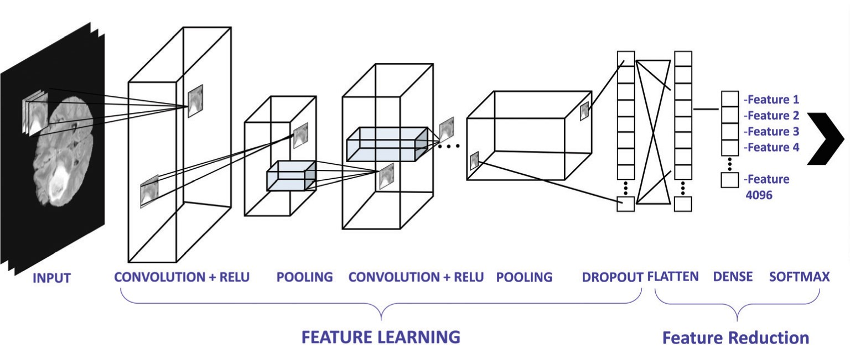
Model Architecture & Compilation
Our model is compiled by defining Loss Function, Optimizer and metrics.
We have used Categorical cross entropy, Adam optimizer and Accuracy as a metric to judge our model.
Callbacks can help you fix bugs more quickly and can help you build better models. They can help you visualize how your model’s training is going, and can even help prevent overfitting by implementing early stopping or customizing the learning rate on each iteration.
In this project, we have used TensorBoard, ModelCheckpoint and ReduceLROnPlateau callback functions.
Fig 3: Neural Network Architecture

Slide 10
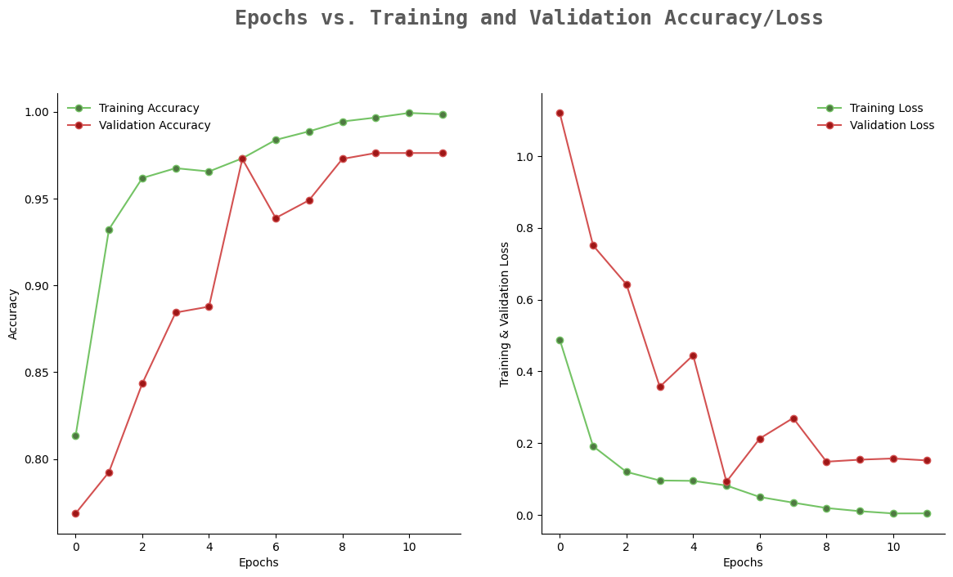
Model Training & Evaluation
Fig 4: Model Training : Training / Validation Accuracy vs Loss

Slide 11
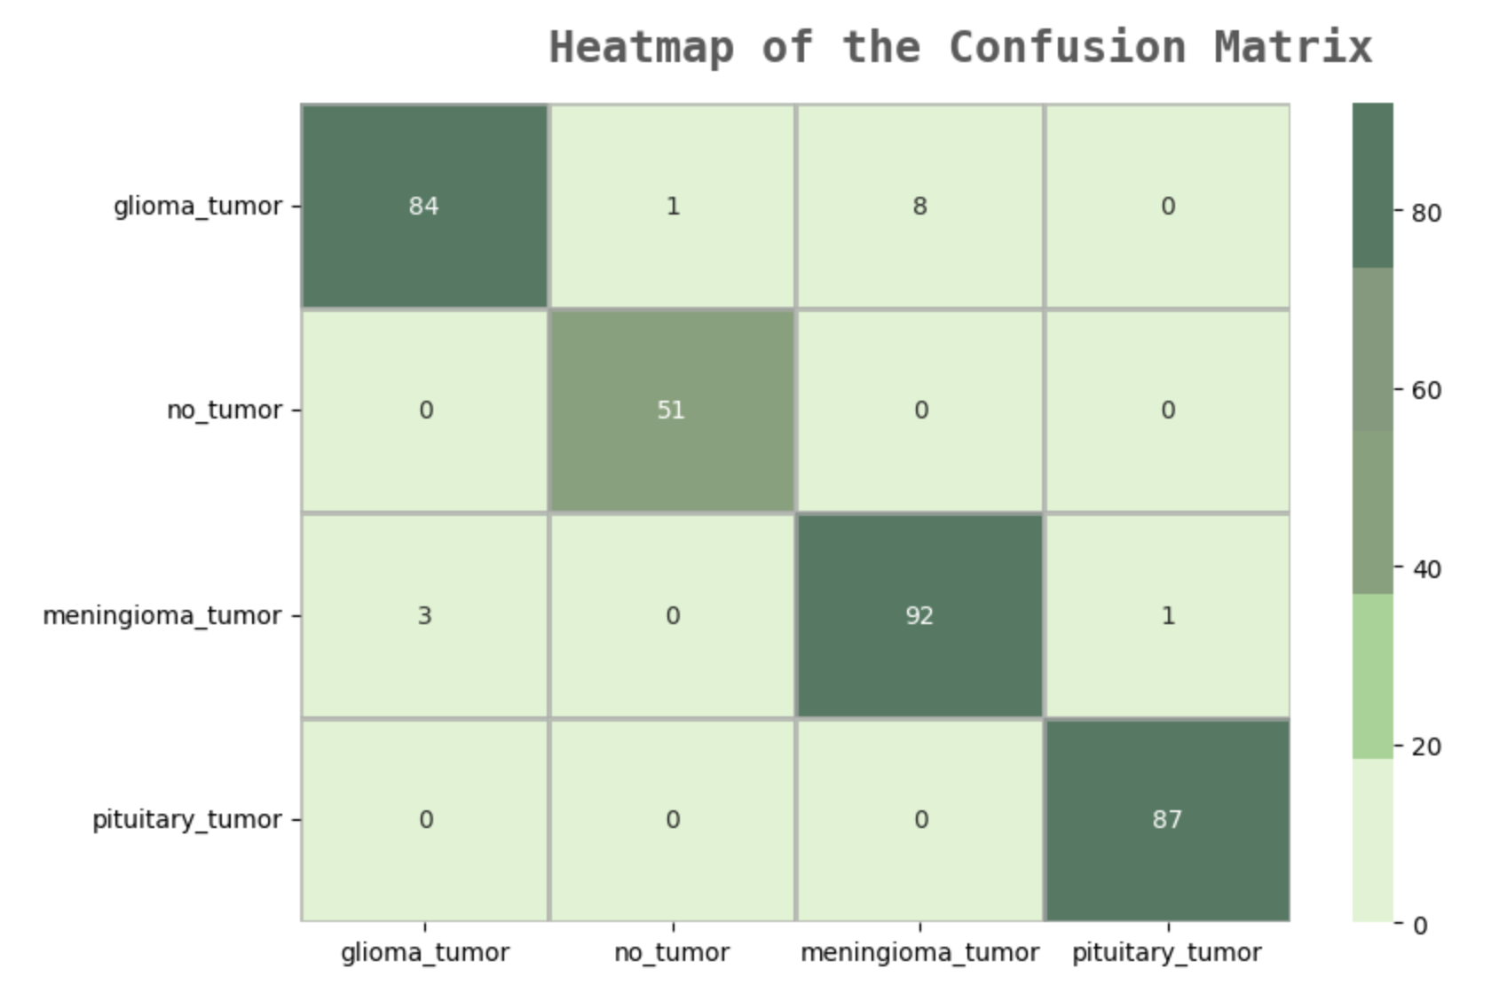
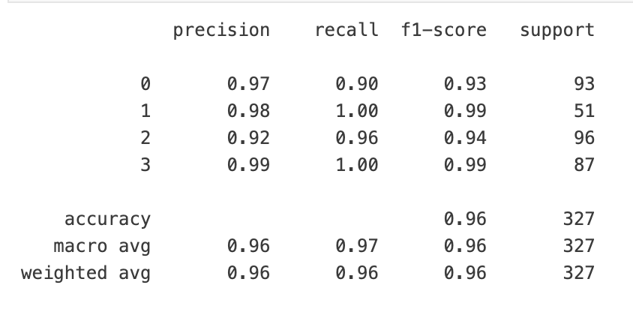
Model Training & Evaluation
Github Repository Link
Fig 5: Classification Report
Fig 6: Confusion Matrix
Observations:-
The results of this project represent a significant step forward in the development of a reliable and accurate brain tumor classification tool.
With a high accuracy rate, F1 score, and a high recall score of 96%, this model exhibits the potential to aid medical professionals in diagnosing brain tumors with confidence.

Slide 12
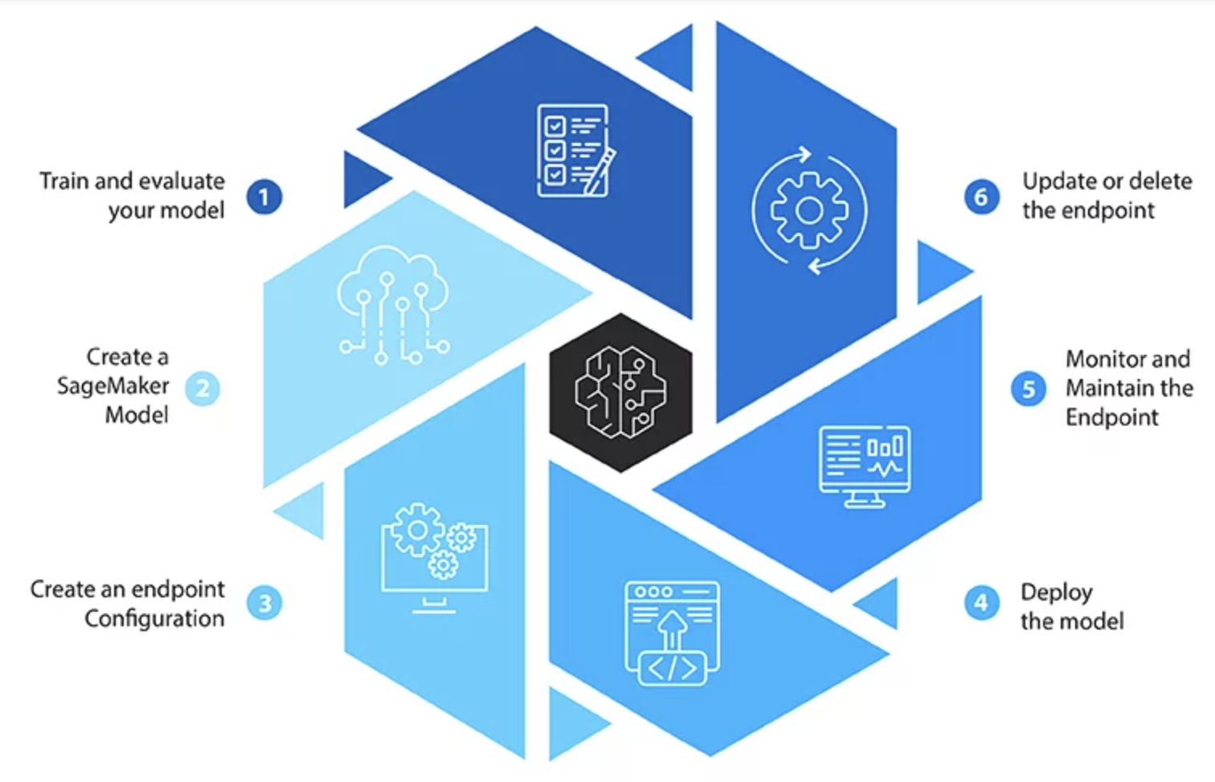
Future Scope (AWS Cloud Development)
Fig 7: Model Deployment

Slide 13
Conclusion
In conclusion, this project successfully demonstrated the power of transfer learning and CNNs in classifying 3 types of brain tumor using MRI data. The model achieved an impressive accuracy, precision & recall of 97% and can be a valuable tool in assisting medical professionals in diagnosing brain tumors.
Furthermore, the future deployment of the model on AWS will make it accessible to a broader audience, potentially improving patient outcomes and streamlining the diagnostic process in healthcare.
This project showcases the potential of deep learning and cloud deployment in solving critical healthcare challenges. The combination of advanced neural network architectures and cloud infrastructure can contribute to more efficient and accurate medical diagnoses.

Slide 14
Thank You

